Slide 1
How an A.I. ‘Cat-and-mouse Game’ generates Believable Fake photos

Slide 2
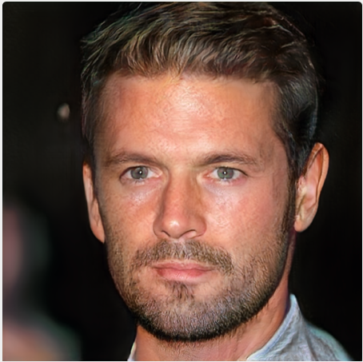
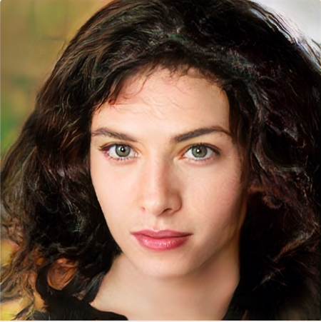
Which one do you think is generated by an A.I.

Slide 3
To generate realistic images:
Analyze big amount of snapshots
Recognize common patterns
Create new “real” images

Slide 4
Neural network:
Artificial neurons
Adaptive weights
Learning algorithm
Cost function

Slide 5
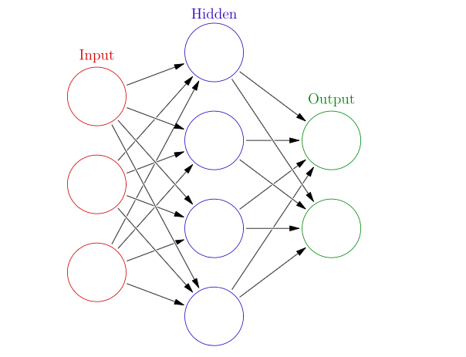
A simple model of neural network:

Slide 6
Generative Adversarial Networks (GAN):
A generative model
(learn the joint probability distribution)
Two competing neural networks
(the generator and the discriminator)

Slide 7
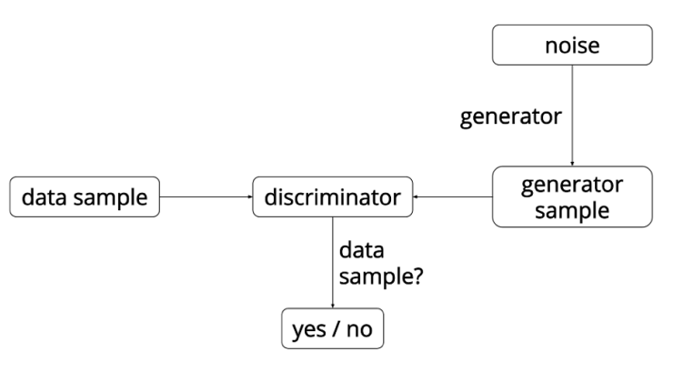
A general overview of GAN:

Slide 8
What can we do with this technique:
Computer interfaces
Movies
Games
Advertising
Fashion
Image reconstruction (for scientists and researchers)

Slide 9
Concerns:
Easier for people to create fake images
The rise of fake news on social media
Harder for public to discern truth from falsity

Slide 10
References:
Cade Metz and Keith Collins (2018, Jan 2) https://www.nytimes.com/interactive/2018/01/02/technology/ai-generated-photos.html
Alex Castrounis (2016, Oct 14) https://www.kdnuggets.com/2016/10/artificial-intelligence-deep-learning-neural-networks-explained.html
John Glover (2016, Aug 24) http://blog.aylien.com/introduction-generative-adversarial-networks-code-tensorflow/
Generative model. In Wikipedia. https://en.wikipedia.org/wiki/Generative_model

Slide 11
Thank you!

